Slide 1
Shell Scripting

Slide 2
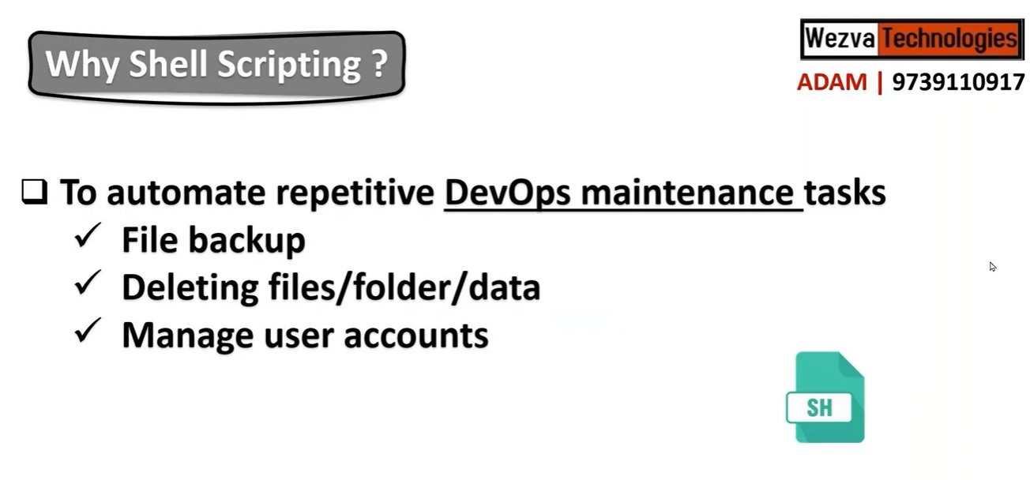

Slide 3
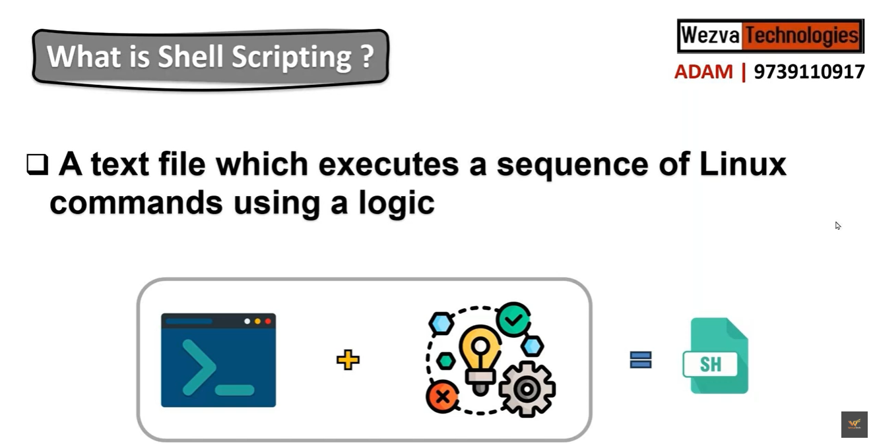

Slide 4
Shell Script contains
Variables (wt kind, wt parameters)
Arguments
Condition
Loop
Functions
(sequence of CMDs need to run multiple times in same script)

Slide 5
Project-1
Real-world in Docker
Deployment
scenario-1:
U have Kubernetes.
inside Kubernetes, there is a docker engines running.
So that docker engines helps Kubernetes to creates a containers
for Deployment.
Scenario 2:
U r not using Kubernetes, to create a container.
Or
U want to create / deploy a container / application on a stand alone machine.
So, we need to tool like Docker engine, compose on a single machine
Scenario 3:
will be using docker for building a image

Slide 6
When we create container / image,
docker machine/ host all the meta data will store in
/var/lib/docker
Image – contains image related data
Containers – contains containers / appln related meta data
Volumes – if need to share data b/w host & container while creating container/launching an appln.
Network / overlay2 – network communication

Slide 7

In a date-to-day work, maintaining all docker machines with following tasks
Images what we are creating it should referring to ID or proper Tag.
If the images doesn’t have proper tag, those images should get deleted.
Dangling images: every images should have proper reference & cache.
Else those needs to be deleted.
Delete Older images: TC of older images need to be cleared, which is not needed.
Delete all stopped / exited containers: to utilize waste storage with unwanted containers/IMGs
Delete unused volumes
docker rm
docker rm –i
docker rm volume
Garbage Collection or Docker maintenance
16.00

Slide 8
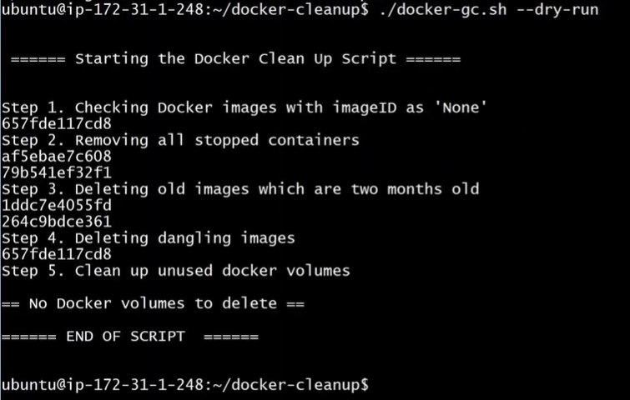
Project-1
DRYRUN : It shows, what is going to do.
if its disabled -> it will deleted all containers & IMGs
Types to use the DRYRUN CMDs
$ ./docker-gc.sh --dry-run
$ ./docker-gc.sh -h -> HELP
$ ./docker-gc.sh

Slide 9
Project-2
Jenkins for maintenance / backup / clear old backup as per version defined
Default path of Jenkins installed in (Jenkins Home path)
/var/lib/jenkins
Plugins
secrets
users
Workspace
Config.xml / credentials
Nodes
37.00→

Slide 10
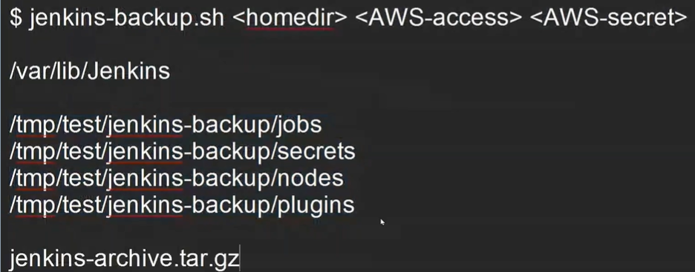
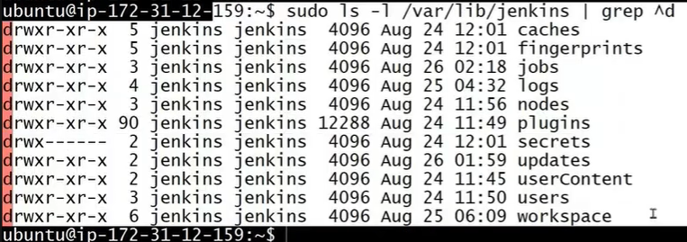
discord old builds in Jenkins (default option in jenkins)
- pipeline jobs
- secrets
- nodes
- Plugins
Backing up the entire Jenkins for HA (frequently)
- jobs, logs, nodes, plugins, secrets, users
- backup should be in single file (.tar/.zip)
Here we are taking backup in AWS storage called s3 bucket

Slide 11
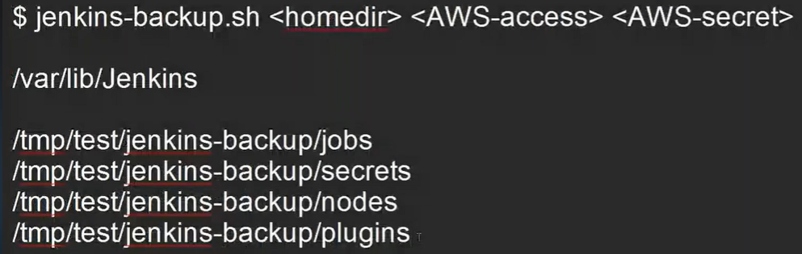
$ Jenkins-backup.sh <home_directory_path> <AWS_Access_Key> <AWS_Secret_Key>
So as per the script, backup file will named as Date&time wise, so there is no chance of replacing of over-written.

Slide 12
Project-3
Creating & managing users (on standalone / legacy machine / on-site server)
- Create / delete multiple users
& assign them to group
with share generated random pwd (using openssl rand -base64 12) to them.
        1.18.45 →

